Slide 1
Desfășurarea unor activități digitale
https://read.bookcreator.com/Uf46cCzp32RBuiPEvOExZFuOMZl1/OVeke0TuR52MOmij_SRrTg

Slide 2
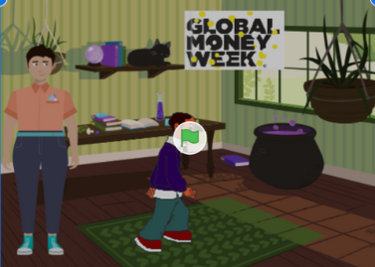
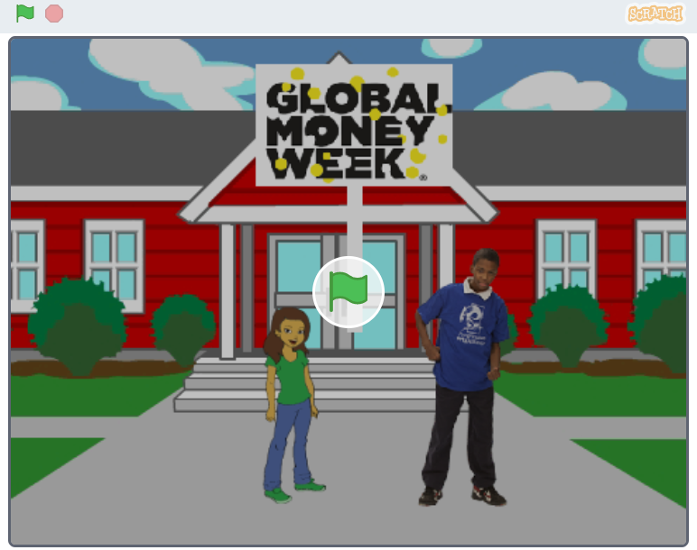
Proiecte realizate în platforma Scratch
https://scratch.mit.edu/projects/822518153/embed
https://scratch.mit.edu/projects/822806124/embed

