Slide 1
Tips to save
Money Matters Matter

Slide 2
General Savings Tips

Slide 3
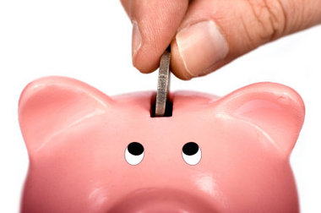
Build an emergency fund
It can make all the difference. Low-income families with at least $500 in an emergency fund are better off financially than moderate-income families with less saved up.

Slide 4
Establish your budget.
Are you looking for an easy way to begin? On the first day of a new month, get a receipt for everything you purchase. Stack the receipts into categories like restaurants, groceries, and personal care. At the end of the month you will be able to clearly see where your money is going.

Slide 5
Make a savings plan
Those with a savings plan are twice as likely to save successfully. That's where America Saves comes in. If you take the America Saves Pledge, we'll help you set a goal and make a plan. And it doesn’t stop there. America Saves will keep you motivated with information, advice, tips, and reminders to help you reach your savings goal. Think of us as your own personal support system.

Slide 6
Calculate purchases by hours worked instead of cost
Take the amount of the item you're considering purchasing and divide it by your hourly wage. If it’s a $50 pair of shoes and you make $10 an hour, ask yourself if those shoes are really worth five long hours of work.

Slide 7
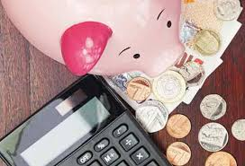
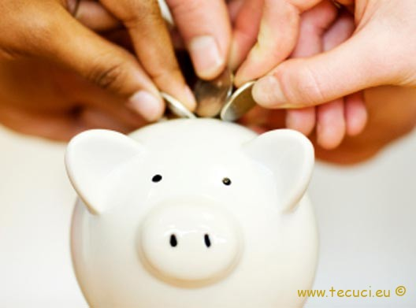
Family and Friends Savings Tips

Slide 8
Create a family spending limit on gifts
Discuss placing spending limits on gifts within your family and/or a system where you only purchase one gift for one person over the holidays. These limits tend to reduce expenditures and be greatly appreciated by family members with less financial flexibility. Plan gift-giving well in advance. That will give you time to decide on the most thoughtful gifts, which usually are not the most expensive ones. And if these gifts are products that must be purchased, you will have the opportunity to look for sales.

Slide 9
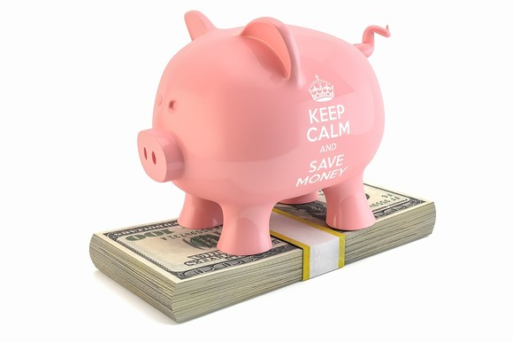
Designate one day a week a "no spend day."
Reserve one night a week for free family fun. Cook at home, and plan out free activities such as game night, watching a movie, or going to the park.

Slide 10
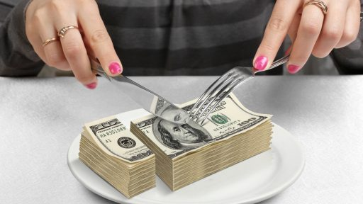
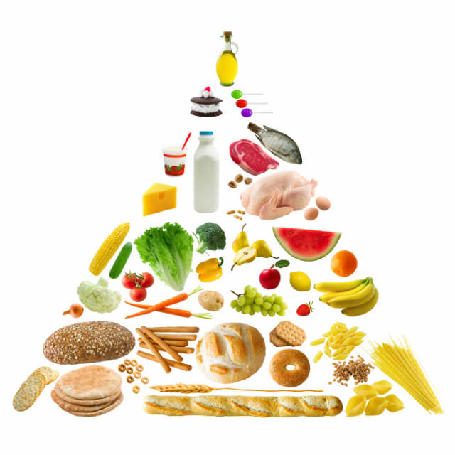
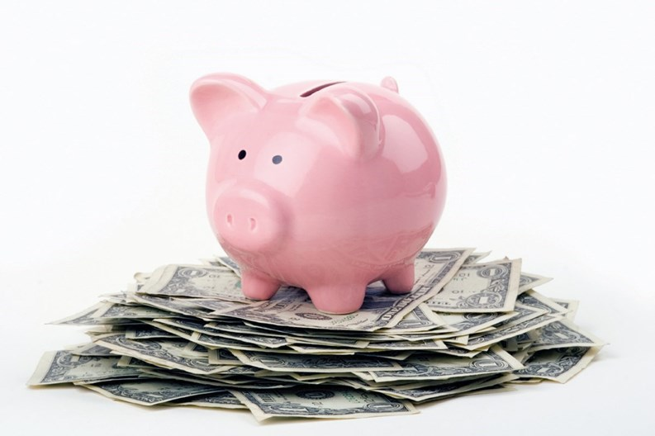
Food Savings Tips

Slide 11
Brown bag your lunch
The reason you hear this tip so much is that it works! If buying lunch at work costs $5, but making lunch at home costs only $2.50, then in a year, you could afford to create a $500 emergency fund and still have money left over.
Commit to eating out one fewer time each month. Save money without sacrificing your lifestyle by taking small steps to reduce your dining budget. Start off with reducing the amount you eat out by just once per month.

Slide 12
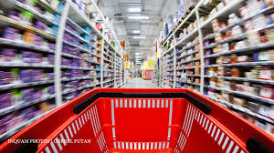
Plan your meals in advance and stick to a list while grocery shopping
People who do food shopping with a list, and buy little else, spend much less money than those who decide what to buy when they get to the food market. The annual savings could easily be hundreds of dollars.

Slide 13
Shop by unit price.
Many grocery stores list a cost per unit of each item, such as the price per ounce or pound. Use these stickers when comparison shopping for the same product, just in a different size.
Save time and money by doubling the recipe.
Next time you make a family favorite, double the recipe and freeze the leftovers for another day. That way you can get two meals out of one and use the ingredients more efficiently with less waste.

Slide 14
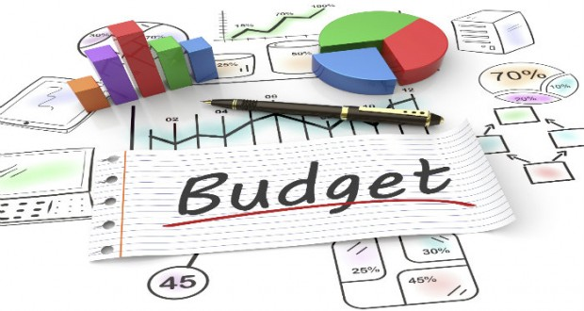
Make a budget
Once you have an idea of what you spend in a month, you can begin to organize your recorded expenses into a workable budget. Your budget should outline how your expenses measure up to your income—so you can plan your spending and limit overspending. In addition to your monthly expenses, be sure to factor in expenses that occur regularly but not every month, such as car maintenance.

Slide 15
Plan on saving money
Now that you’ve made a budget, create a savings category within it. Try to put away 10–15 percent of your income as savings. If your expenses are so high that you can’t save that much, it might be time to cut back. To do so, identify non-essentials that you can spend less on, such as entertainment and dining out.

Slide 16
By : Popescu Daniela
Molea Camelia
Mema Mihaela
Clasa a X-a
Colegiul National Traian
Mehedinti , Romania
Money Matters Matter

